Slide 1

LICENSE PLATE DETECTION USING
‘PYTHON’ AND ‘OPENCV’
Submitted by
DILIP KUMAR R (211519104034)
KARTHICK ARAVIND E T (211519104065)
KISHORE KUMAR R (211519104074)
SUPERVISOR
Mr.S.KAVIARASAN,M.E
Assistant Professor and Supervisor.

Slide 2
ABSTRACT
Every country's traffic management and the car owner detecting has become a key issue. It might be difficult to detect the vehicle owners who were not following the traffic laws and drive too quickly at times. As a result, it is impossible to catch and penalize such individuals since traffic officers may be unable to extract a car license number from a moving vehicle due to the speed of the vehicle. As a result, one of the answers to this challenge is to design an Automatic Number Plate Recognition (ANPR) system. There are many ANPR systems on the market now. These systems use many approaches, but it is still a difficult process because factors like as vehicle speed, nonuniform vehicle number plates, vehicle number language, and lighting conditions can all have an impact on the overall identification rate. The majority of systems operate within these constraints. Different ANPR techniques are discussed in this work, with image size, success rate, and processing time as criteria. An extension to ANPR is suggested at the end of this work.. The characters are read in the final phase using correlation template matching, which is a simple but effective method of identifying structured text with a small number of characters. The speed and mistake rate of the system are also assessed. In the fourth chapter, the conclusions and future work are presented.

Slide 3
INTRODUCTION
ANPR stands for automated number plate recognition. In recent years, ANPR or license plate recognition LPR has proven to be one of the most effective methods for vehicle surveillance. It uses python and open cv for the operation. The steps involved in ANPR are as follows.
Image capture of the vehicle
Number plate detection
Character segmentation
Recognition of characters.

Slide 4
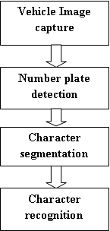
ARCHITECTURE OF ANPR

Slide 5
SYSTEM ANALYSIS
Existing system : ANPR used In many systems some of the existing systems are
Law enforcement
Car parking system
Traffic management
Retail park security
Tollbooth records

Slide 6
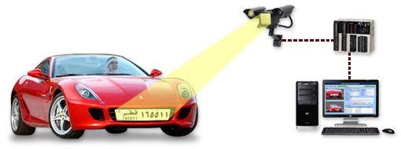
Proposed system : One of the paper's main goals is to assess the effectiveness of ZigBee, a short-range wireless technology, in Intelligent Transportation Systems. Figure 2 depicts the proposed configuration of a system for conducting various experiments to collect data and assess ZigBee behavior in transportation systems. The proposed method allows for wireless data transmission up to 1 kilometer.

Slide 7
HARDWARE AND SOFTWARE REQUIRED
HARDWARE USED IN ANPR SYSTEM
SmartCAM ANPR / LPR Camera
FXCAM LPR / ANPR Camera
FXVD4 Frame Grabber Card
Desktop with required Specification
SOFTWARE USED IN ANPR SYSTEMS
ALPR Software
Back-End Software
database

Slide 8
SYSTEM ARCHITECTURE
A system architecture, often known as a systems architecture, is a conceptual model that describes a system's structure, behaviour, and viewpoints.
This architecture can be classified into the following categories:
Client Application (Front-End).
Server Side (Back-End).

Slide 9
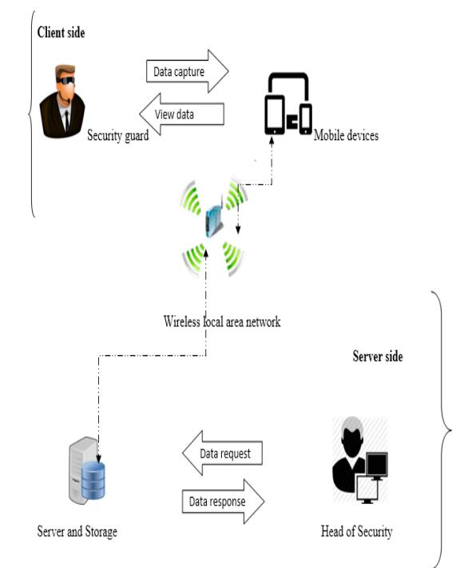
.

Slide 10
LIST OF MODULES
Digital Image Processing,
Optical Character Recognition(OCR),
Web Crawler,
Database,
Graphical User Interface,
Tkinter,
OPENCV,
Tesseract Engine.

Slide 11
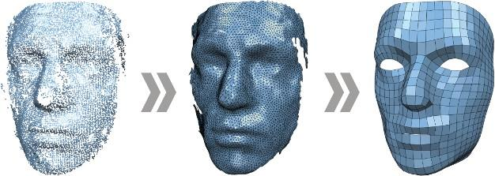
MODULE DESCRIPTION
Digital Image Processing
Signal processing is a discipline in electrical engineering and in mathematics that deals with analysis and processing of analog and digital signals , and deals with storing , filtering , and other operations on signals. These signals include transmission signals , sound or voice signals , image signals , and other signals e.t.c.

Slide 12
Steps in Digital Image Processing
➢ Image Preprocessing
➢ Image Enhancement
➢ Image Transformations
➢ Thematic Information
Advantages of Digital Image Processing
Images can be given more sharpness and better visual appearance.
Minor errors can be rectified.
Image sizes can be increased or decreased

Slide 13
Problems associated with Digital Image Processing
It is very costly depending on the system used, the number of detectors purchased.
Time consuming
Lack of qualified professional
Optical Character Recognition(OCR)
OCR is a technology that recognizes text within a digital image. It is commonly used to recognize text in scanned documents, but it serves many other purposes as well.

Slide 14

OCR

Slide 15
Techniques of OCR
➢ Pre-processing
➢ Text Recognition
➢ Post-processing
Uses of OCR
➢ Automatic number plate recognition
➢ In airports, for passport recognition and information extraction
➢ Automatic insurance documents key information extraction
➢ Traffic sign recognition
➢ Extracting business card information into a contact list

Slide 16

Web Crawler
A Web crawler, sometimes called a spider or spiderbot and often shortened to crawler, is an Internet bot that systematically browses the World Wide Web, typically operated by search engines for the purpose of Web indexing ( web spidering ).

Slide 17
Database
A database is a collection of information that is organized so that it can be easily accessed, managed and updated.
Types of Database
Relational database
Distributed database
Cloud database
NoSQL database
Object-oriented database Graph database
Firebase database
MySQL database

Slide 18
Graphical User Interface
A GUI (graphical user interface) is a system of interactive visual components for computer software. A GUI displays objects that convey information, and represent actions that can be taken by the user. The objects change color, size, or visibility when the user interacts with them.
Tkinter
Tkinter is the standard GUI library for Python. Python when combined with Tkinter provides a fast and easy way to create GUI applications. Tkinter provides a powerful object-oriented interface to the Tk GUI toolkit.

Slide 19
OPENCV
OpenCV (Open Source Computer Vision Library) is an open source computer vision and machine learning software library. OpenCV was built to provide a common infrastructure for computer vision Applications and to accelerate the use of machine perception in the commercial products.
Tesseract Engine
Tesseract is an engine for optical character recognition (OCR). It’s an integral part of the text detection frameworks for mobile devices and Google spam algorithms

Slide 20
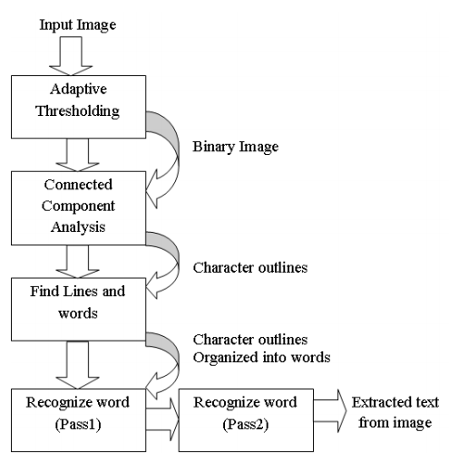
Tesseract Architure of OCR

Slide 21
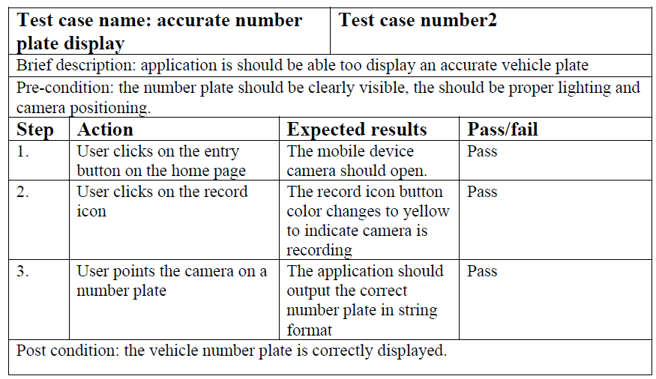
TEST CASE

Slide 22
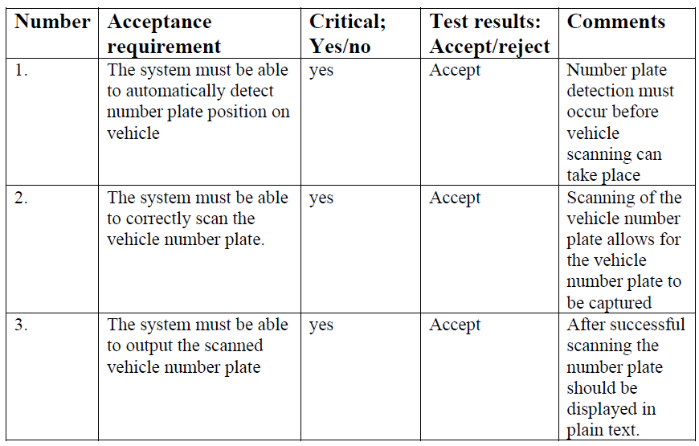

Slide 23
RESULT
The number plate segmentation algorithms in most of the literatures work in limited settings such as illumination, number plate form (usually rectangular), size, and distance from the camera. Color, camera, and vehicle It's worth noting that just a few people are aware of this. Real-time algorithms are used. If A number plate is shown in video. static number plate image is sent to ANPR to be processed further.

Slide 24
CONCLUSION
The completion of the proposed system resulted in the following benefits:
i. Elimination of the hard copy occurrence book and the need to have to physically write onto the book, because all the vehicle details records will be digitized.
ii. Hastening of the vehicle entry registration process, thus shortening the time spent in recording vehicle details as they enter the University.
iii. Accurate recording of vehicle information.
iv. Provides a means of easy information sharing and information backup.
v. Real time information sharing of the vehicles entering and exiting the Institution to the Head of Security.
vi. Easier analysis of the vehicle information captured

Slide 25
FUTURE ENHANCEMENT
ANPR technologies can be implemented in several scenarios whereby there is a need to monitor all vehicles that are accessing or exiting from a particular vicinity. For example ANPR technology can greatly enhance border patrol and border surveillance whereby all the vehicles entering or exiting the country can be quickly checked to see if there are any known offences that relates to that particular vehicle before the vehicle is
granted entry or exit into the country.

Slide 26
REFERENCES
1. You-Shyang Chen and Ching-Hsue Cheng, "A Delphi-based rough sets fusion model
for extracting payment rules of vehicle license tax in the government sector," Expert
Systems with Applications, vol. 37, no. 3, pp. 2161-2174, 2010.
2. Christos Nikolaos E. Anagnostopoulos, Ioannis E. Anagnostopoulos, Ioannis D.
Psoroulas, Vassili Loumos, and Eleftherios Kayafas, License Plate Recognition From
Still Images and Video Sequences: A Survey, vol. 9, no. 3, pp. 377-391, 2008.
3. Christos Nikolaos E. Anagnostopoulos, Ioannis E. Anagnostopoulos, Vassili
Loumos, and Eleftherios Kayafas, "A License Plate-Recognition Algorithm for
Intelligent Transportation System Applications," pp. 377-392, 2006.
4. H. Erdinc Kocer and K. Kursat Cevik, "Artificial neural netwokrs based vehicle
license plate recognition," Procedia Computer Science, vol. 3, pp. 1033-1037, 2011.
5. A Roy and D.P Ghoshal, "Number Plate Recognition for use in different countries
using an improved segmenation," in 2nd National Conference on Emerging Trends
and Applications in Computer Science(NCETACS), 2011, pp. 1-5.
6. Kaushik Deb, Ibrahim Kahn, Anik Saha, and Kang-Hyun Jo, "An Efficeint Method
of Vehicle License Plate Recognition Based on Sliding Concentric Windows and
Artificial Neural Network," Procedia Technology, vol. 4, pp. 812-819, 2012.
7.Lucjan Janowski et al., "Quality assessment for a visual and automatic license plate
recognition," Multimedia Tools and Applications Springer US, pp. 1-18, 2012.

Slide 27
8. Yifan Zhu, Han Huang, Zhenyu Xu, Yiyu He, and Shiqiu Liu, "Chinese-style Plate
Recognition Based on Artificaial Neural Network and Statistics," Procedia
Engineering, vol. 15, pp. 3556-3561, 2011.
9. Fikriye Öztürk and Figen Özen, "A New License Plate Recognition System Based on
Probabilistic Neural Networks," Procedia Technology, vol. 1, pp. 124-128, 2012.
10. Jian Liang, D Dementhon, and D Doermann, "Geometric Rectification of Camera-
Captured Document Images," IEEE Transactions on Pattern Analysis and Machine
Intelligence, vol. 9, no. 3, pp. 591-605, 2008.
11. in Fan and Guoliang Fan, "Graphical Models for Joint Segmentation and Recognition
of License Plate Characters," IEEE Signal Processing Letters, vol. 16, no. 1, pp. 10-
13, 2009.
12. Lihong Zheng, Xiangjian He, Bijan Samali, and Laurence T. Yang, "An algorithm
for accuracy enhancement of license recognition," Journal of Computer and System
Sciences, , 2012.
13. Zhen-Xue Chen, Cheng-Yun Liu, Fa-Liang Chang, and Guo-You Wang, "Automatic
License-Plate Location and Recognition Based on Feature Saliance," IEEE
Transactions on Vehicular Technology, vol. 58, no. 7, pp. 3781-3785, 2009.
14. Ch.Jaya Lakshmi, Dr.A.Jhansi Rani, Dr.K.Sri Ramakrishna, and M. KantiKiran, "A
Novel Approach for Indian License Recognition System," International Journal of
Advanced Engineering Sciences and Technologies, vol. 6, no. 1, pp. 10-14, 2011.
15. Jianbin Jiao, Qixiang Ye, and Qingming Huang, "A configurabe method for multistyle
license plate recognition," Pattern Recognition, vol. 42, no. 3, pp. 358-369,
2009.
16. Zhigang Zhang and Cong Wang, "The Reseach of Vehicle Plate Recogniton Technical
Based on BP Neural Network," AASRI Procedia, vol. 1, pp. 74-81, 2012.

